Slide 1
Trajectory & Rotation
IN613 2013
Lecture 11

Slide 2
Trajectory of Projectiles
Notes:
Things are always being launched in computer games
We want to animate this

Slide 3
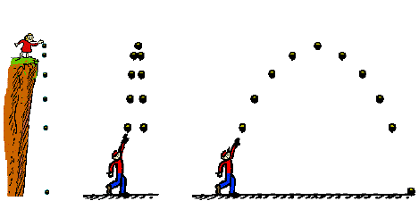
Types of Projectiles
Notes:
There are many different projectile situations, but all can be handled the same way
Essentially we move the object as we have always done, by adding an XVel term and a YVel term.
Accurate (or sufficiently accurate) trajectories are created by using the correct function for XVel(t) - xVelocity as a function of time, or how the speed of the object changes as time passes -- and YVel(t)
Note that this movement is different from the directional movement of your sprite, and must be handled separately.
Specifically, when animating projectile movement, it is simplest to recombine magnitude and direction into xVel and yVel, and allow them to be positive or negative as appropriate.

Slide 4
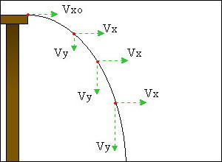
Horizontal and Vertical Velocities
Notes:
The critical thing to remember is that in the real world, over time, horizontal velocity does not change (in the absence of friction, which we will ignore)
Vertical velocity does change, however.
On earth, vertical velocity increases over time due to gravity.
In the figure, note that Vx = Vx0 for all t (i.e. the object moves the same distance in the x-direction at each time unit) but that Vy increases with t (i.e. as time passes, the object moves a larger and larger distance in the y-direction at each time unit).

Slide 5
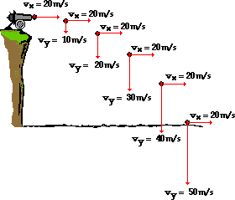
Horizontal and Vertical Velocities
Notes:
The effect is illustrated again here
Note that the acceleration due to gravity is a constant for this planet, and has an actual value (9.8m/s/s).
In games, however, use whatever value makes it look good. This will depend on various things, including the scale of the image

Slide 6
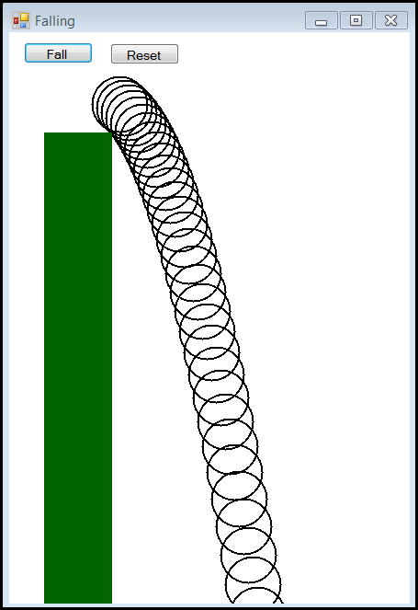
Falling
Notes:
Here’s an example of trajectory code.
The ball starts on top of the pedestal. When the user clicks the button, it falls.
The “ball” is actually just a FillEllipse command at xLoc and yLoc.
xLoc and yLoc are determined using the gravity equations we saw in the previous slides
What we see in this image is the path that it follows, created by leaving its outline at each timer tick
Note the sufficiently realistic arced path.

Slide 7
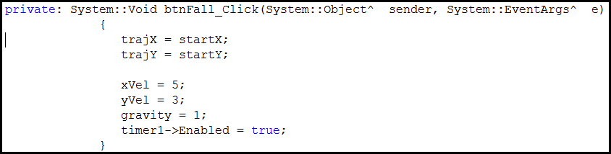
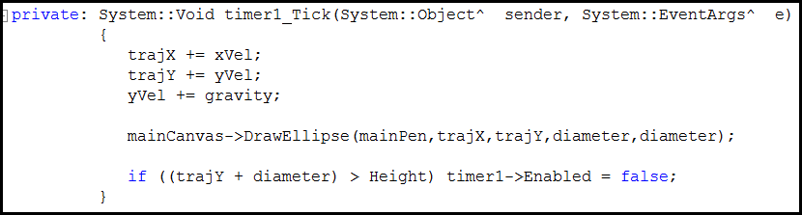
Falling - Code
Notes:
Here’s the code
The start button sets everything up to start from the top of the pedestal with the correct velocities, and turns the timer on
In the timer, we just move the ellipse.
Note that the xVel remains constant, but the yVel is increased by gravity at each time.
This is all the code that is needed to implement the simulation

Slide 8
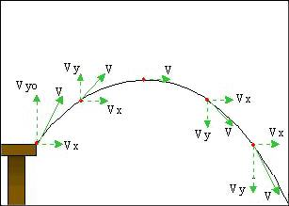
Launching
Notes:
Objects launched upwards have a parabolic trajectory
This is easy to implement.
Simply start with an initial negative Y velocity. Eventually, you will increment it by gravity enough times that it will become positive, and the object will start to fall…..

Slide 9
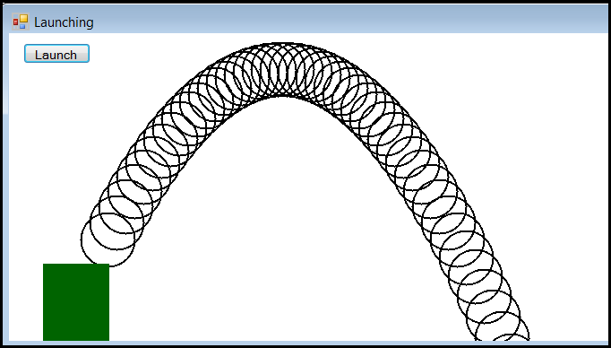
Launching
Notes:
Here is the launching demo

Slide 10
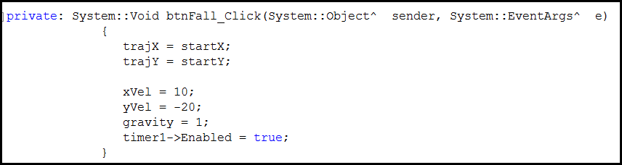
Launching - Code
Notes:
This is the only change
Later we will see how to select good values for the initial x and y velocities based on the orientation and power of the launching device.

Slide 11
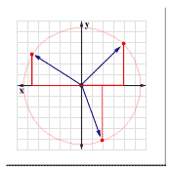
Rotation
Orienting objects in a circular space
Notes:
We have until now always dealt with our objects from a linear perspective – move them so many units along the x-axis, and so many along the y-axis.
Often, however, we want to deal with objects in, sort of, a circular perspective. For example we might want to turn an object some number of degrees, we might want to rotate an object some number of degrees.
To do these things, we need to think about angles around a circle.
Note however, that angles around a circle still have linear components. Every point on the circumference of a circle is just an (x,y) pair.

Slide 12
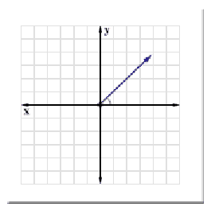
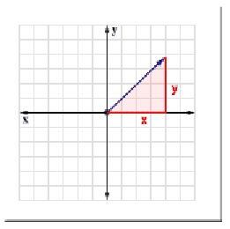
(X,Y) Coordinates and Triangles
Notes:
If we think of any point in space, we can view it relative to the origin (0,0)
Its x and y values determine a right triangle with the origin, as illustrated.
The relationships between the angle at the origin, the length of the line, and the lengths of x and y are constant.
That is, for a given angle, the ratios of the length (hypotenuse) and the legs are fixed.

Slide 13

Sine and Cosine
sine(angle) = y/hypotenuse
cosine(angle) = x/hypotenuse
Notes:
As y gets longer, h gets longer too, to maintain the angle. For a fixed angle, the ratio of y to h is a constant.
This ratio is called the “sine” of the angle.
The same is true for x and h. That ratio is the cosine.
The sine and cosine of any angle can be gotten from the computer
Math::Sin and Math::Cos
We can use these relationships to do lots of useful things

Slide 14
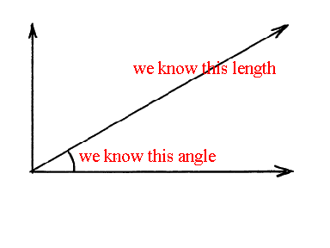
Drawing at an Angle
Notes:
Imagine, for example, that we want to draw a line of d pixels, off at angle a.
This is sort of like Turtle graphics
Assume 0,0 is the origin. Then if you knew x and y of the endpoint, you could use the Graphics::DrawLine(pen,stpt,endpt) command
What are x and y?

Slide 15
Drawing at an Angle
sin(angle) = Y / d
cos(angle) = X / d
Y = sin(angle) * d
X = cos(angle) * d
Notes:
If we are starting from 0,0 we just draw the line to X,Y
If we are starting from any other start point, we just add X to our current x coordinate and Y to our current y coordinate.

Slide 16
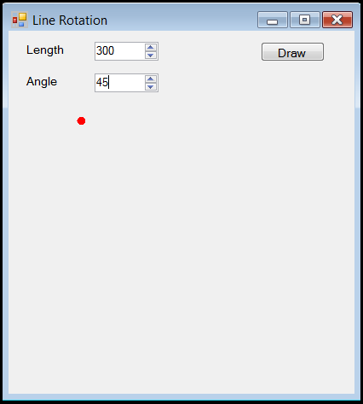
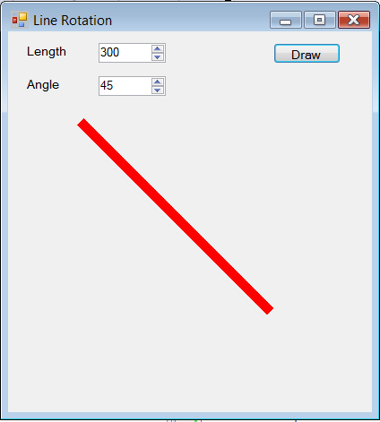
Drawing at an Angle
Notes:
We could build an application like this
You have the start point. You use the equations on the previous slide to compute x and y for a line of length 300 and an angle of 45
That tells you how many pixels to move in the x direction, and how many pixels to move in the y direction
Note that the angle is defined relative to the algebraic number line, where 0 degrees is pointing East, and angle goes clockwise.
Note also that the trig functions are all computed relative to (0,0). Our line doesn’t start at (0,0), it starts at the location of the red dot.
To make this work, we have to “translate” the line. This is just a fancy name for shifting it over by adding a value to x and y.
We’ll see this in the code…..

Slide 17
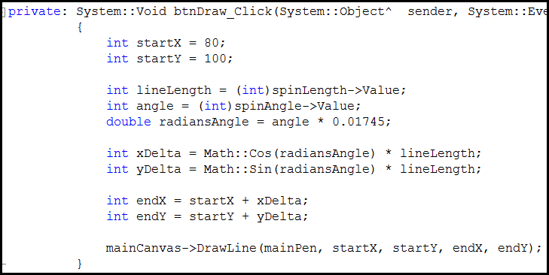
Drawing at an Angle - Code
Notes:
One other thing to note here
Math functions don’t do angles in degrees, they do them in radians. 2*Pi radians = 360 degrees. So you must translate your angle in degrees into some fractional radian, as shown.

Slide 18
General Rotation
Given X1, Y1 and angle
NewX = X1*cos(angle) – Y1*sin(angle)
NewY = X1*sin(angle) + Y1*cos(angle)
Notes:
If you think about it, what we did was take the point (D,0) and rotate it around the origin (0,0) by the specific angle.
In the more general case, you can take any point (X,Y) and rotate it around it (0,0) by a given angle
The equations are given. (You can go through the maths yourself…)
Take some time this evening to look over the maths here and make sure you understand it. Tomorrow, we will use these computations to fire cannons at things.

